Slide 1
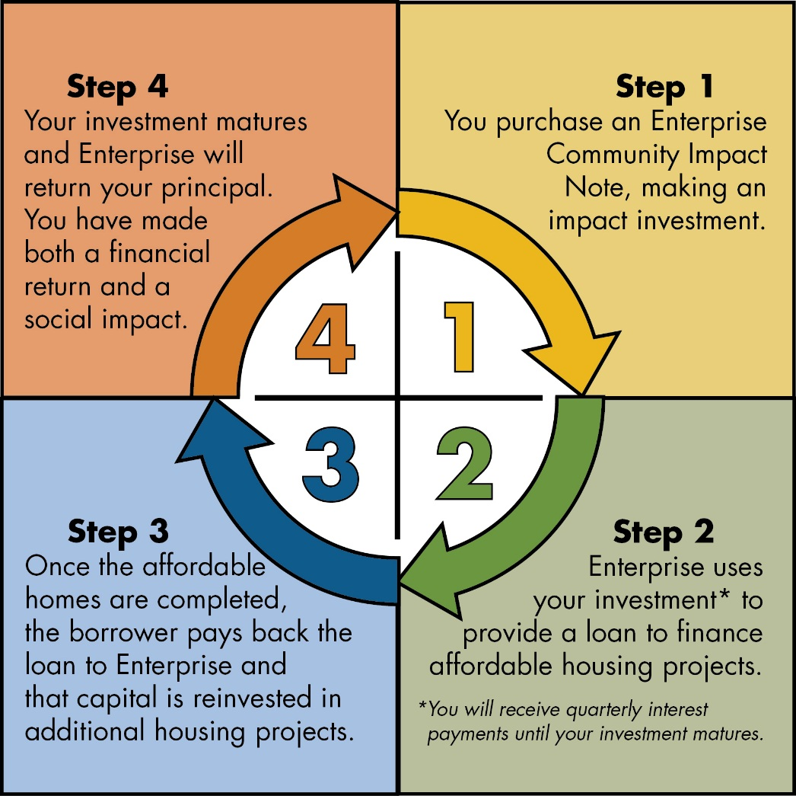
Enterprise Community Loan Fund
Enterprise Community Impact Note
Launched 2010
Investors = individuals & organizations
Raised $45 million → 300 investments
Offered in 31 states & Washington, D.C.
Features
Fixed terms (2 – 10 years)
Fixed rates (1.5 – 3.5%)
$5,000 minimum investment
Guarantee from parent company
Social and Financial Reporting

Slide 2
Enterprise Community Loan Fund
Raising Impact Note Capital in 2016
Targeted Initiatives
Our Region, Your Investment = opportunity for local stakeholders to address the housing crisis in the Washington, D.C. region through impact investing
Washington Regional Association of Grantmakers = membership association of grantmakers serving the region lifting up impact investing as a new capital tool to support affordable housing
Engaging Donor-Advised Funds
Donor-Advised Fund = philanthropic vehicle that allows donors to set aside capital which will be deployed as grants over time
National Philanthropic Trust = nation’s largest DAF manager announced value-aligned investment options for uncommitted capital

Slide 3
Enterprise Community Loan Fund
The Convergence of CDFIs and Impact Investing
Can CDFIs Capture the Momentum Around Impact Investing?
Jeremy Nowak’s research on CDFI growth and capitalization
CDFI capital sources have largely been motivated by regulatory concerns. There is an emerging opportunity to appeal to socially-motivated capital sources through impact investing.
To capture that capital, we need to solve for these barriers:
Branding CDFI industry
Marketing CDFI impact and investment opportunities
Developing infrastructure/platform to plug-in investors
Offering investment products that meet investor needs

Slide 4
Enterprise Community Loan Fund
Enterprise’s Investment in Addressing Barriers
ImpactUS
Platform for CDFIs to offer impact investing opportunities and service investments
Solve for brand, marketing, platform, and product barriers
Accelerating Impact Investing Initiative (AI3)
Launched in 2013 to spark a national conversation about the federal government’s role in improving and expanding the market for impact investments
Partnership with Pacific Community Ventures and Harvard’s Initiative for Responsible Investment

