Slide 1
Risk and Efficiency among CDFIs: A Statistical Evaluation using Multiple Methods
Gregory B. Fairchild, University of Virginia, Darden GSBA
Ruo Jia, Stanford GSB

Slide 2
Primary research questions
Are CDFIs more likely to fail than their non-CDFI counterparts?
Are they more vulnerable to mortgage market downturns?
Are they less efficient, ceteris paribus?
Why? For some, operation in low-income, high unemployment, and underserved areas is necessarily associated with risk

Slide 3
How to answer these questions?
Lots of data

Slide 4
Risks of failure
Model of key financial measures that contribute to regulatory intervention: merger, closure
Developed to evaluate bankruptcy risks in 1960’s, applied to many industries
Prediction of regulatory action within 2 years (8 quarters)
Data: Quarterly call reports for every quarter, 2000-2012: 3000 banks, 600 credit unions
Results:
Banks were slightly less likely to fail, ceteris paribus
Rural and Low Income CUs were less likely to fail, ceteris paribus

Slide 5
Systemic Risks
Notion: Mortgage Market interconnectedness facilitates contagion
Data and Model: Same as Institutional Risks, with HMDA measures
Two measures: dominance, centrality
Results:
CDFI Banks that dominate their mortgage markets are more likely to fail
CDFI CUs find no effect for either measure
Taken together: CDFIs have no greater systemic risks than their counterparts
Of course, ceteris paribus

Slide 6
Efficiency of CDFIs
An alternative model used in Industry Analysis, Inputs and Outputs
Based on financial measures
Sets an “Efficient Frontier”
Answers a question of some about subsidy
Area of chartered service controls (BEA, BLS)
Virtually no difference in performance
(and in some cases, CDFIs more efficient)

Slide 7
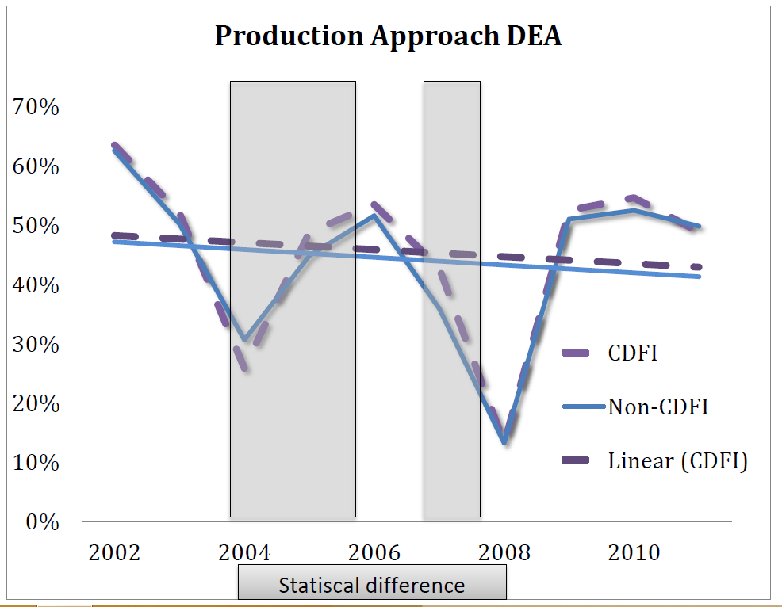

Slide 8
Future Avenues
Quality of “M”?
Process that facilitates this difference.
Dominance and information access
Prescriptive benefits of each model
Limitations by asset size and organizational form
Use and impact of technology
Impact of CDFI Fund appropriations

