Slide 1
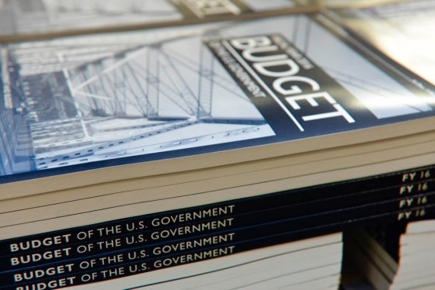
Alison Feighan, Rapoza Associates
David Reich, Center on Budget and Policy Priorities
Nick Wyatt, Senate Finance Committee

Slide 2
U.S. Senate Democrats Republicans
113th Congress
114th Congress
45
55
54
46
*Includes Independents Bernie Sanders (VT) and Angus King (ME) who caucus with Democrats
Notes:
Republicans gain 9 seats. The turn over of 9 seats was the largest since the Reagan revolution of 1980.

Slide 3
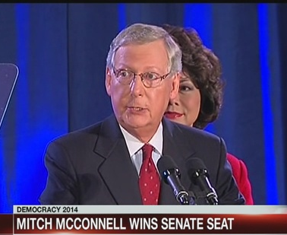
New Senate Leadership - GOP
Mitch McConnell (R-KY), Majority Leader
Jon Cornyn (R-TX), Majority Whip
John Thune (R-SD), Republican Conference Chair
Roy Blunt (R-MO), Republican Conference Vice-Chair
John Barrasso (R-WY), Republican Policy Committee Chair
Notes:
There are 11 certified CDFIs working in Kentucky

Slide 4
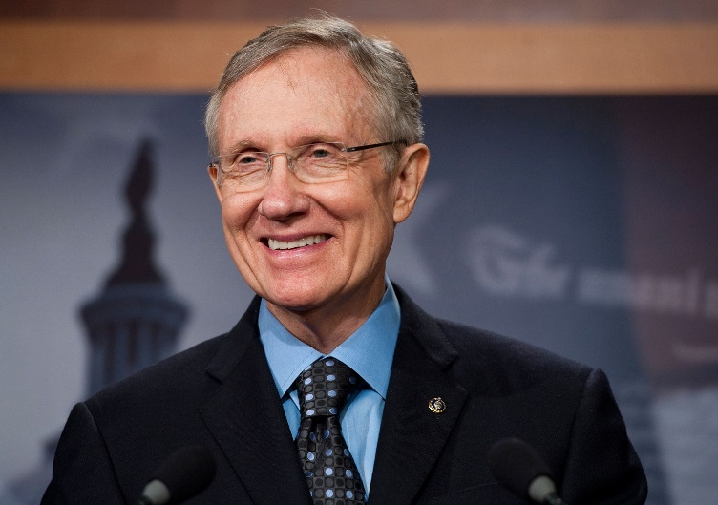
New Senate Leadership - Dems
Harry Reid (D-NV), Minority Leader & Democratic Conference Committee Chair
Richard Durbin (D-IL), Minority Whip
Charles Schumer (D-NY), Democratic Policy Committee Chair
Patty Murray (D-WA), Democratic Conference Secretary
Notes:
Elizabeth Warren will also serve on the Senate Democratic Leadership Team
Harry Reid up for reelection in 2016

Slide 5
U.S. House of Representatives
Republicans picked up 13 seats
Notes:
Largest Republican Majority since Herbert Hoover
Obama has lost 69 seats since taking office

Slide 6
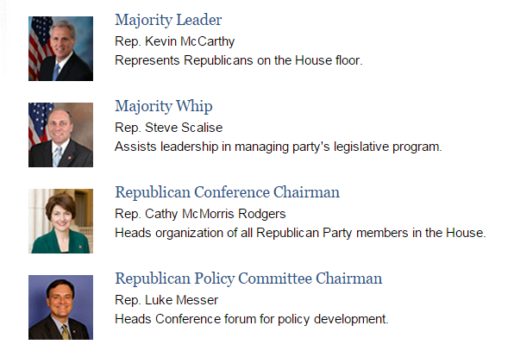
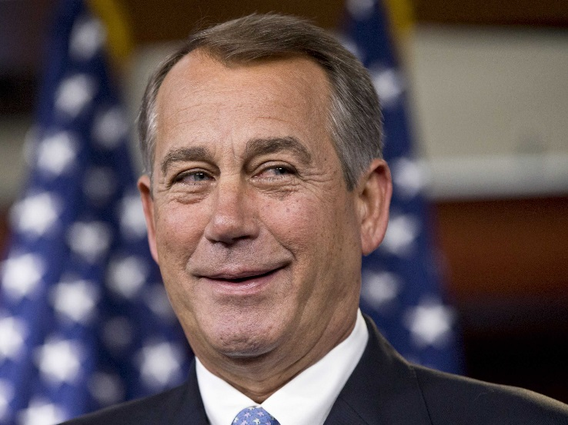
House GOP Leadership
Speaker of the House
Rep. John Boehner
Notes:
McCarthy (California) took over for Eric Cantor late last year
Scalise from Louisiana
McMorris Rodgers (Washington)
Luke Messer (Indiana). His district includes large portion of eastern Indiana, including Muncie and Richmond, as well as a few suburbs of both Cincinnati, and Indianapolis.

Slide 7
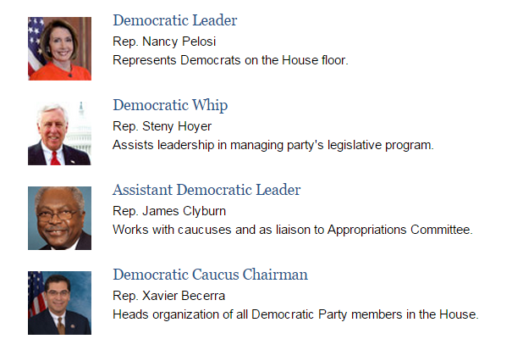
House Democratic Leadership
Notes:
The minority party in the House has less power to influence legislation than they do in the Senate, because there isn’t a filibuster.

Slide 8
Committee Changes, 114th Congress

Slide 9
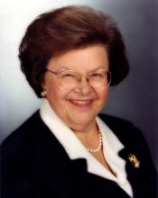
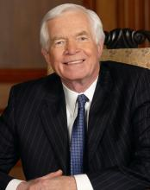
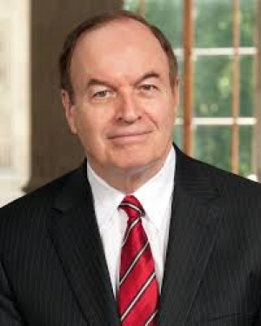
Senate Appropriations Committee
Thad Cochran (R-MS), Chairman
Barbara Mikulski (D-MD), Ranking Member
Barbara Mikulski (D-MD), Chair
Richard Shelby (R-AL), Ranking Member

Slide 10
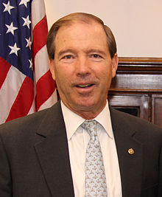
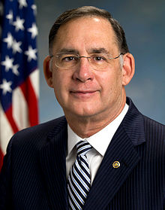
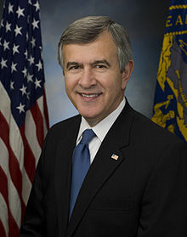
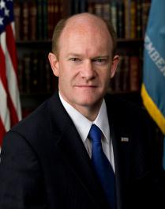
Senate Financial Services and General Government Subcommittee, Appropriations
John Boozman (R-AR), Chairman
Chris Coons (D-DE), Ranking Member
Tom Udall (D-NM), Chairman
Mike Johans (R-NE), Ranking Member

Slide 11
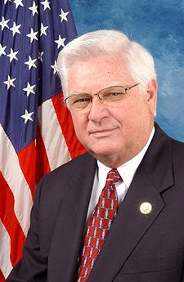
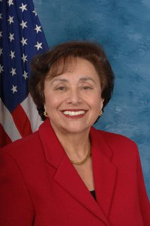
House Appropriations Committee
Hal Rogers (R-KY), Chairman Nita Lowey (D-NY), Ranking Member

Slide 12
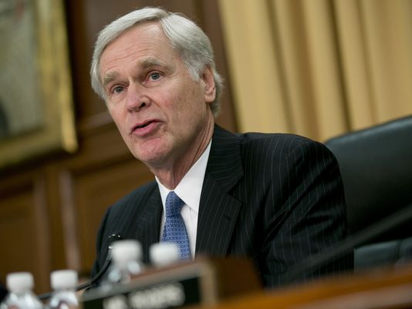
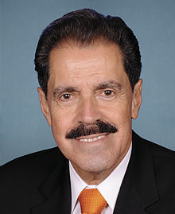
House Financial Services and General Government Subcommittee, Appropriations
Ander Crenshaw (R-FL), Chairman
José Serrano (D-NY), Ranking Member
Notes:
No changes in leadership

Slide 13
House Approps Subcommittee Chairs
More conservative → → → →
Dotted line is the ideology of the average
House Republican
Notes:
Despite the House Republican caucus being fairly conservative, the subcommittee chairs are relatively moderate compared to the median Republican member of Congress.

Slide 14
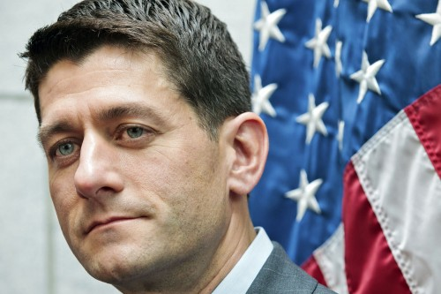
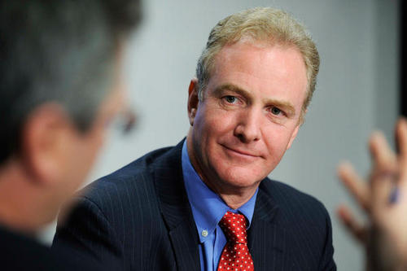
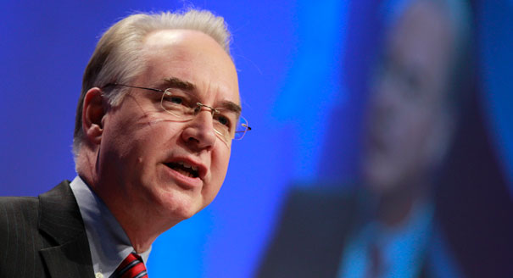
House Budget Committee
Tom Price (R-GA) replaces Paul Ryan (R-WI)
Chris Van Hollen (D-MD), Ranking Member
Notes:
Tom Price: Very conservative. National Journal Conservative Rating of 86.7 out of 100 in 2013
Van Hollen stays on as Ranking Member.

Slide 15
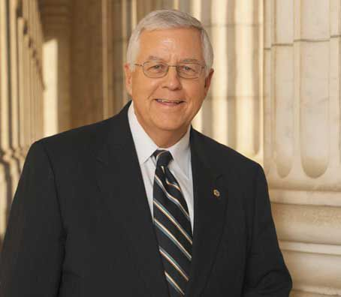
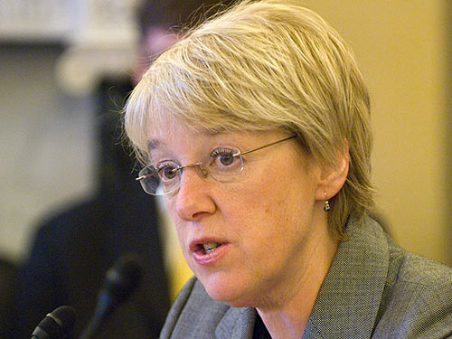
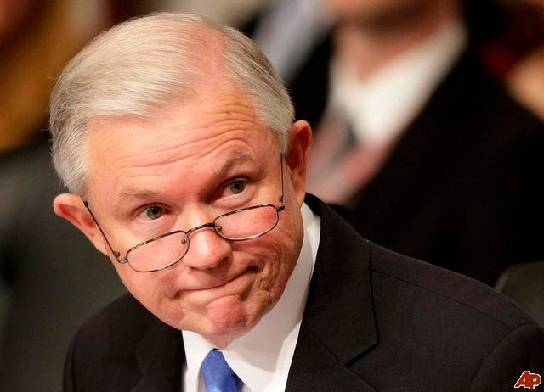
Senate Budget Committee
Patty Murray (D-WA) replaces Jeff Sessions (R-AL) as Ranking Member
Mike Enzi (R-WY) replaces Patty Murray (D-WA) as Chair

Slide 16
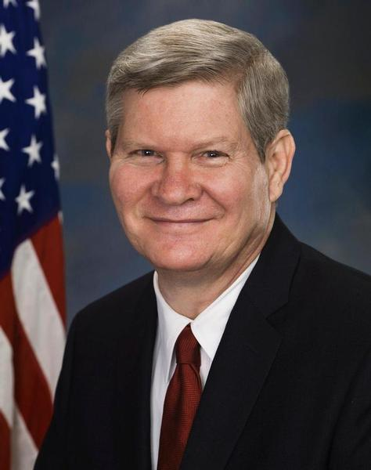
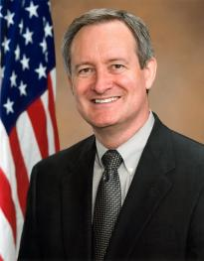
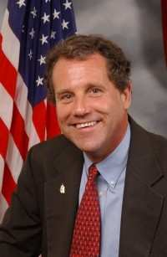
Senate Banking, Housing, and Urban Affairs Committee
Richard Shelby (R-AL), Chairman
Sherrod Brown (D-OH), Ranking Member
Tim Johnson (D-SD), Chairman
Mike Crapo (R-ID), Ranking Member
Notes:
Newly elected members on this committee include:
Ben Sasse (R-NE)*
Tom Cotton, USAR (R-AR)*

Slide 17
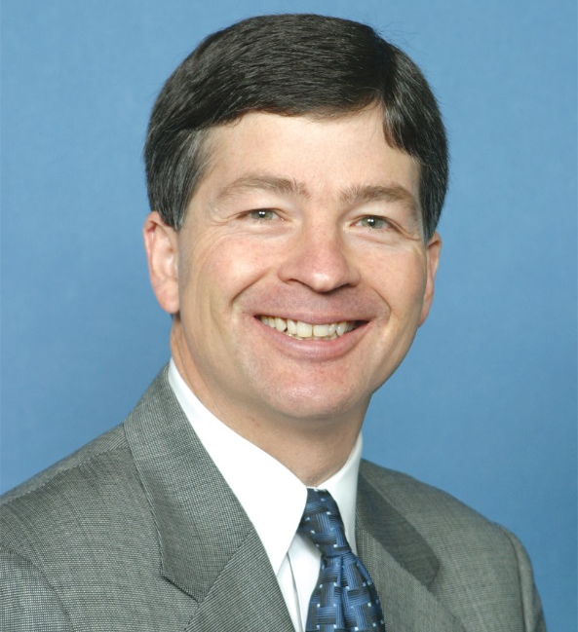
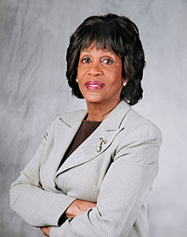
House Financial Services Committee
Jeb Hensarling (R-TX), Chairman Nita Lowey (D-NY), Ranking Member
Notes:
Newly elected members:
Bob Dold, Jr. (R-IL) *
Frank Guinta (R-NH) *
Bruce Poliquin (R-ME) *
Mia Love (R-UT) *

Slide 18
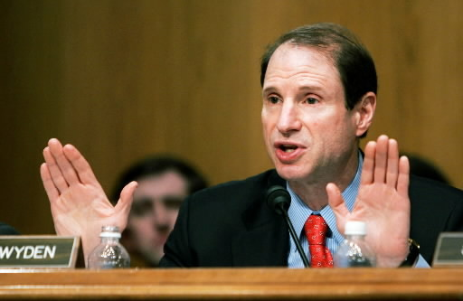
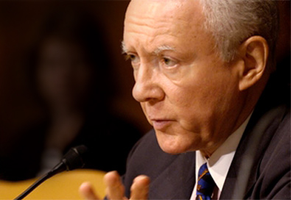
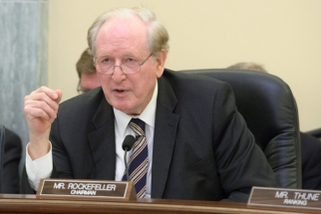
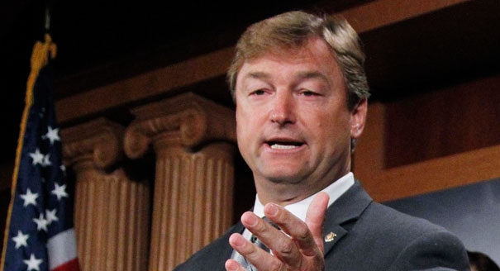
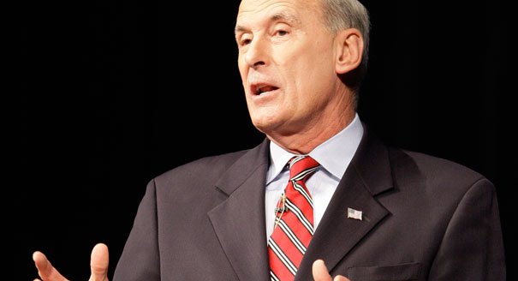
Senate Finance Committee
Ron Wyden (D-OR), former Chairman, Now Ranking Member
Orrin Hatch (R-UT) takes over Committee
New Members
Leaving:
Possible New Members
Heller (R-NV)
Coats (R-IN)
Rockefeller (D-WV)
Scott (R-SC)

Slide 19
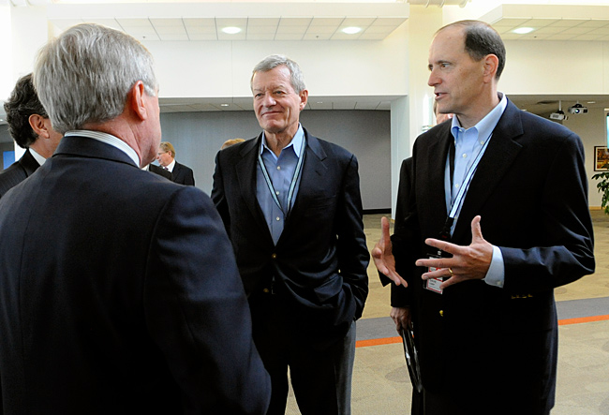
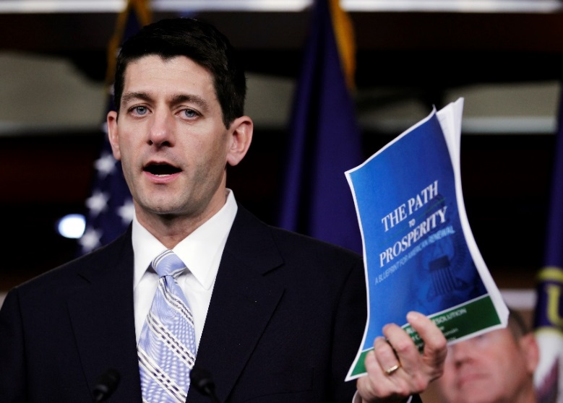
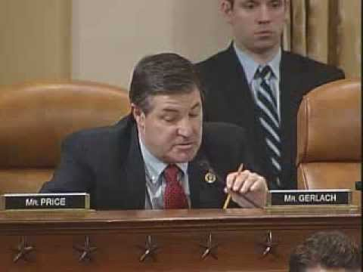
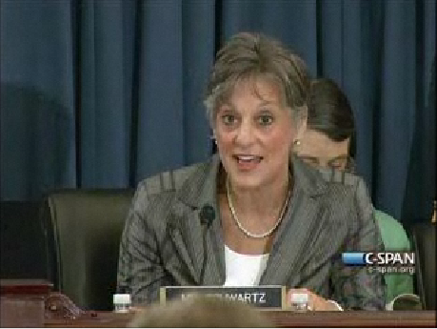
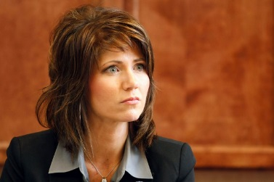
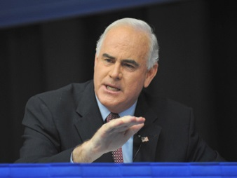
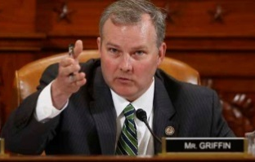
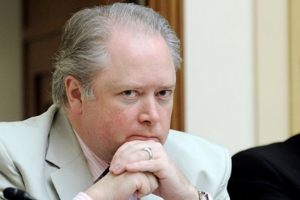
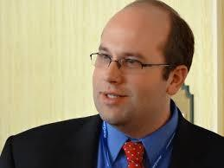
House Ways and Means
Dave Camp (R-MI) Retires
Paul Ryan (R-WI) takes over
Leaving the Committee:
Joining the Committee
Pat Meehan (R-PA)
Kristi Noem (R-SD)
Jason Smith (R-MO)
George Holding (R-NC).
Jim Gerlach (R-PA) Tim Griffin (R-AR) Allyson Schwartz (D-PA)
Notes:
Jim Gerlach (R-PA), Tim Griffin (R-AR), and Allyson Schwartz (D-PA) to run for governor There will four new Republican members of Ways and Means.
Dave Camp was term limited and retired. He will be succeeded by Paul Ryan.

Slide 20
Decline in Community Development Spending As a Share of GDP
Notes:
The community and regional development function in the federal budget includes CDBG, HOME, Indian programs , EDA, USDA rural development.

Slide 21
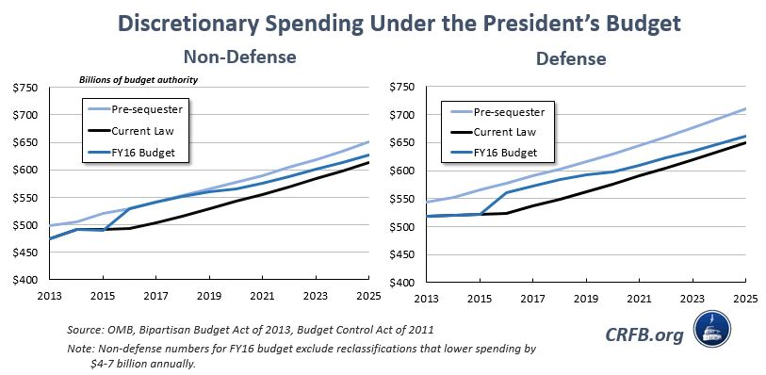
Impact of the Sequester
Notes:
The President’s FY 2016 Budget rescinds a good deal of the Sequester cuts for both defense and non-defense discretionary spending.
Congressional Republicans will likely seek to retain the Sequester, but shift defense cuts to domestic spending.

Slide 22
CDFI Fund Appropriations: A Happier Story
Notes:
(Now you turn it over to David)

Slide 23
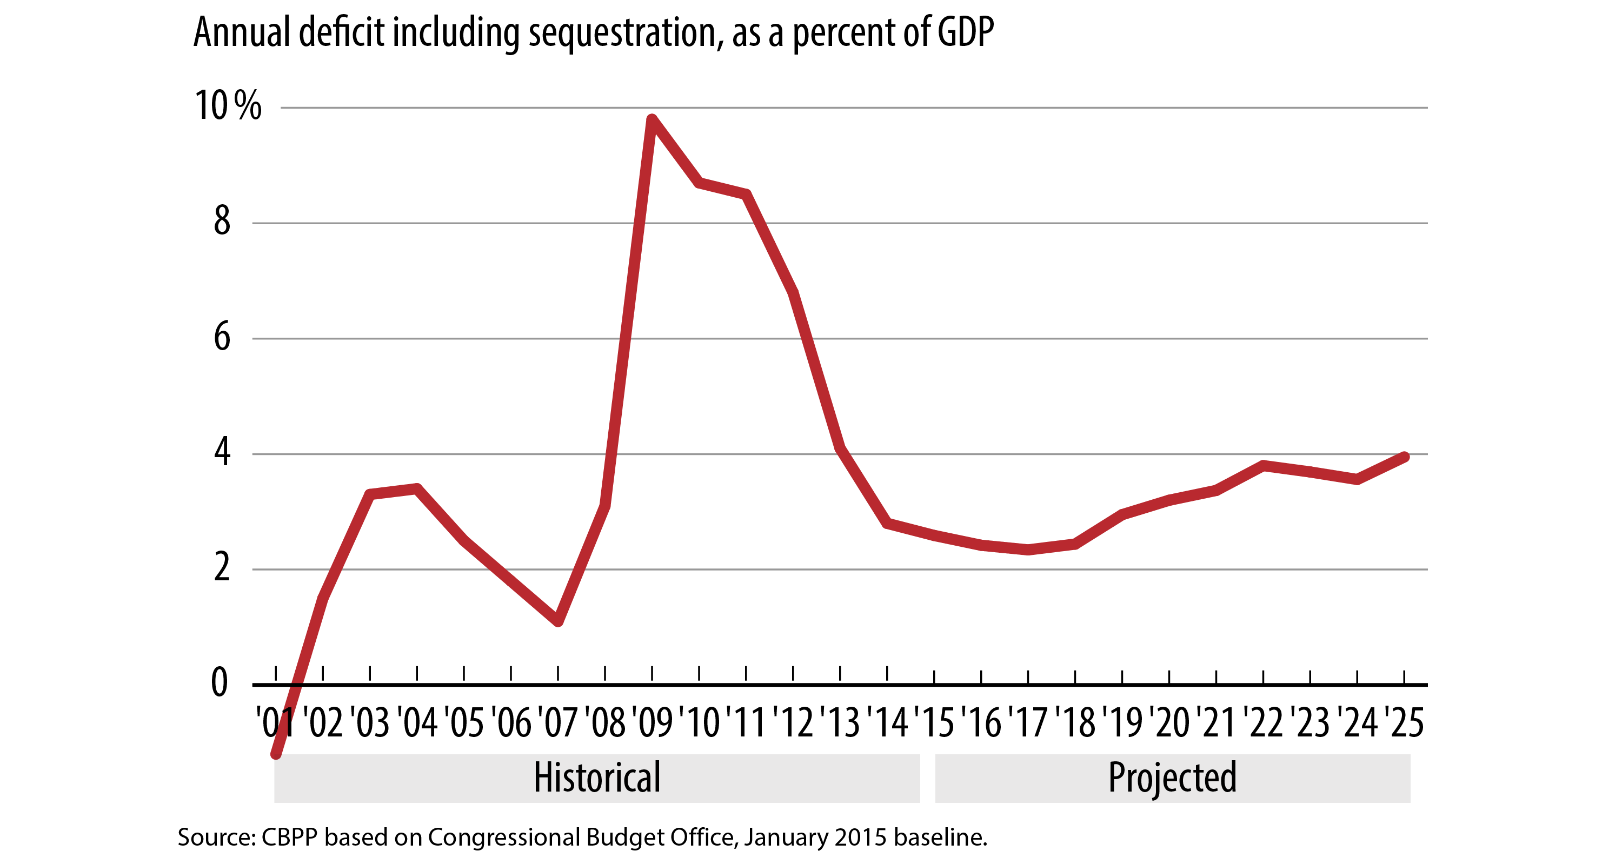
Deficits Have Fallen Sharply Since Recession

Slide 24
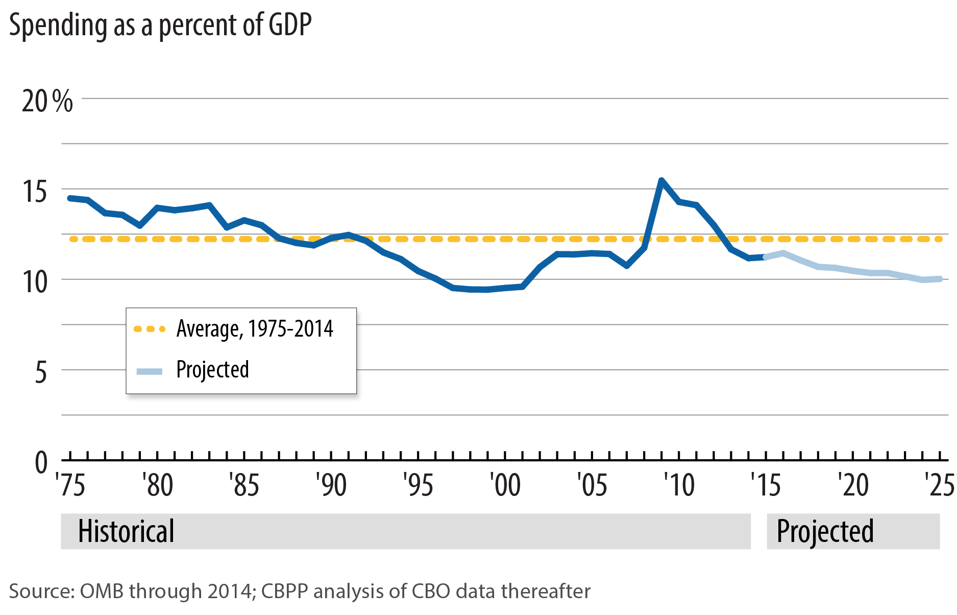
Non-Interest Spending Outside of Social Security and Medicare Below Historical Average

Slide 25
Major Health Programs including Health Reform Now Projected to Cost Less Than in January 2010 without Health Reform
Spending in billions of dollars, 2011-2020
Note: Baseline projections of Medicare, Medicaid, health insurance subsidies, and Children’s Health Insurance Program for fiscal years 2011-2020. January 2015 projections include actual spending for FY 2011-14.
Source: CBPP analysis based on Congressional Budget Office estimates.

Slide 26
NDD Levels Have Fallen Since 2010

Slide 27
Non-Defense Discretionary Spending Falling to Historic Lows

Slide 28
CDFI Appropriations Request
 | FY 11 | FY 12 | FY 13 | FY 14 | FY 15 | FY 16 Budget Request | FY 16 CDFI Coalition Request
CDFI Fund Appropriation | $227 | $221 | $221 | $226 | $230.5 | $233.5 | $233.5
- CDFI Program (FA/TA) (Healthy Foods) | 175 (25) | 168 (22) | 168 (22) | 167.5 (22) | 174.4 (22) | 192.6 (35) | 174.6
Native Initiatives | 12 | 12 | 12 | 15 | 15 | 16 | 16
Bank Enterprise Award | 22 | 18 | 18 | 18 | 18 | 0 | 18
Admin Expenses | 18 | 23 | 23 | 24.6 | 23.1 | 24.9 | 24.9
CDFI Bond Program | n/a | n/a | 500 | 750 | 750 | 1000 | 1000
Chart in millions of dollars
Notes:
Requesting the president’s budget, which is level funding from FY 2015.

Slide 29
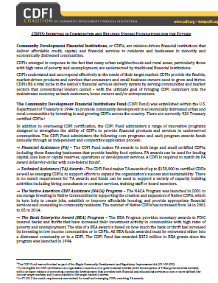
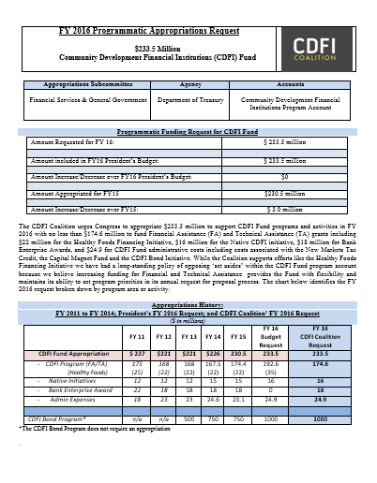
Advocacy Tips and Talking Points
Notes:
Request Form
Fact Sheet

